Slide 1




AI Resume Ranker
Name : Bipin Shivkumar Yadav
Email : bipinyadav919@gmail.com
Guide: Saomya Chaudhury
Disclaimer: The content is curated for educational purposes only.
Notes:
Slides: Prepare a short slide deck (10-12 slides) summarizing the project objectives, methodology, and key results.

Slide 2
Problem Statement
Manual resume screening is time-consuming and inefficient for recruiters.
Traditional keyword-based filtering fails to assess true relevance of skills.
High volume of applications makes it difficult to identify top candidates.
Bias in manual screening can lead to inconsistent hiring decisions.
Need for an automated AI-driven solution to rank resumes based on relevance.
Using TF-IDF and Cosine Similarity to improve accuracy and efficiency.
Ensures faster, unbiased, and data-driven candidate selection.

Slide 3
Proposed Solution
Develop an AI-powered Resume Ranker that automates resume screening.
Use TF-IDF (Term Frequency-Inverse Document Frequency) to extract key features from resumes and job descriptions.
Implement Cosine Similarity to measure the relevance of resumes to the job description.
Rank resumes based on their similarity scores, ensuring the most relevant candidates are prioritized.
Provide a user-friendly interface to input job descriptions and upload multiple resumes.
Display ranked resumes in descending order based on relevance scores.
Improve hiring efficiency, reduce manual workload, and minimize bias in candidate selection.

Slide 4
Software Requirments
Programming Language: Python
Framework: Streamlit (for web-based UI)
Libraries:
PyPDF2 (for extracting text from PDF resumes)
scikit-learn (for TF-IDF and Cosine Similarity calculations)
Pandas (for data handling and ranking visualization)
Machine Learning Techniques: TF-IDF, Cosine Similarity
Development Environment: Jupyter Notebook / VS Code / PyCharm
Version Control: GitHub (for code management)
Deployment Platform: Streamlit Cloud / Local Server / Cloud Platforms (AWS, Azure, GCP)

Slide 5
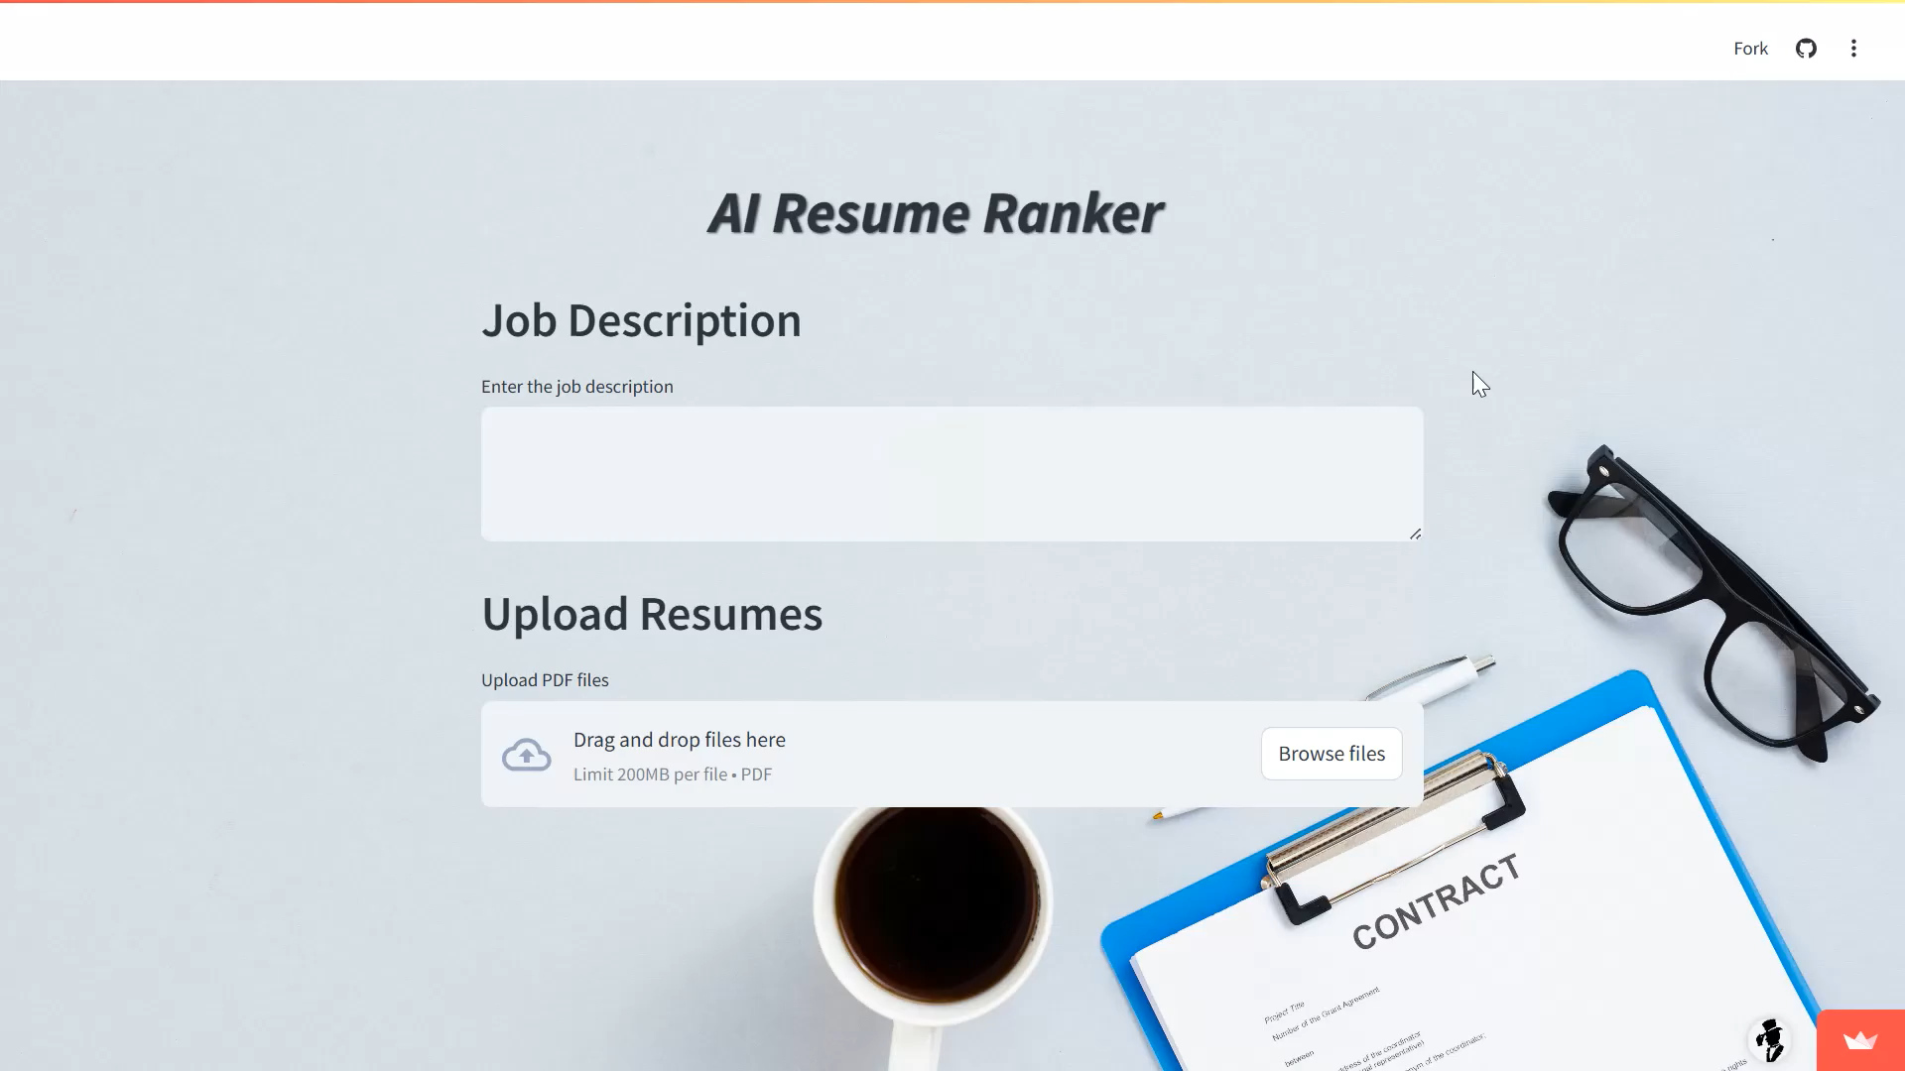
Live Demo of Project

Slide 6
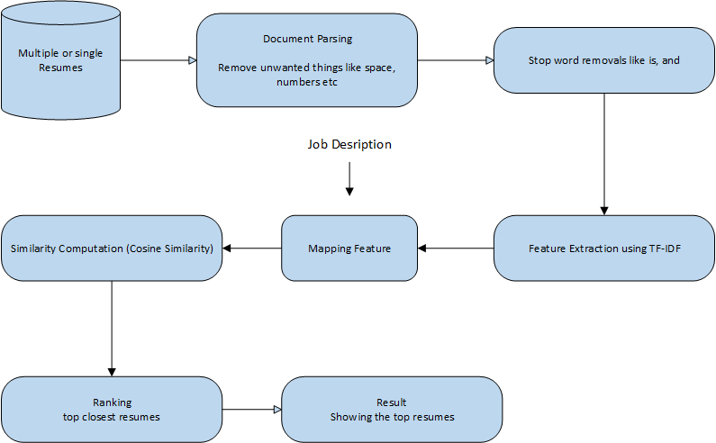
System Architecture

Slide 7
Future Scope
Improve text extraction by integrating NLP techniques and handling various resume formats (PDF, DOCX, etc.).
Machine Learning Integration: Use deep learning models like BERT or GPT for better semantic understanding and ranking.
Multi-Criteria Ranking: Incorporate experience, skills, certifications, and job relevance for more precise ranking.
Real-Time Updates: Allow recruiters to update job descriptions dynamically and receive instant re-ranking of resumes.
ATS Integration: Integrate with Applicant Tracking Systems (ATS) for seamless recruitment workflow.
Multi-Language Support: Extend support for different languages to cater to global recruitment needs.

Slide 8
Conclusion
AI Resume Ranker automates resume screening using TF-IDF and Cosine Similarity, reducing manual effort.
Ensures fair, unbiased, and efficient ranking of resumes based on job descriptions.
Provides a user-friendly interface for easy resume uploads and ranking visualization.
Helps recruiters quickly identify the most relevant candidates, improving hiring efficiency.
Can be further enhanced with deep learning models, better parsing techniques, and multi-format support.
Demonstrates the impact of AI in recruitment, making the hiring process smarter and faster.

Slide 9
Thank you!
Notes:
thank you very much for joining this PPT, keep learning.
9

